Slide 1
Indexing

Slide 2
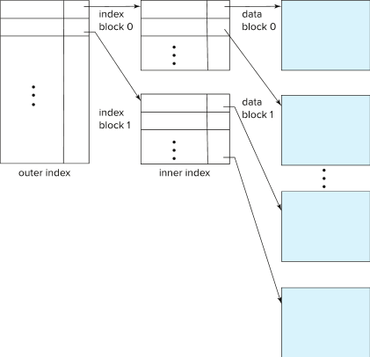



B⁺-Tree Index Files
Disadvantage of indexed-sequential files
  Performance degrades as file grows, since many overflow blocks get created (How?).
  Periodic reorganization of entire file is required.
10101
22222
83821

Slide 3
B⁺-Tree Index Files
Advantage of B⁺-tree index files:
  Automatically reorganizes itself with small, local, changes, in the face of insertions and deletions.
  Reorganization of entire file is not required to maintain performance.
(Minor) disadvantage of B⁺-trees:
  Extra insertion and deletion overhead, space overhead.
Advantages of B⁺-trees outweigh disadvantages
  B⁺-trees are used extensively

Slide 4
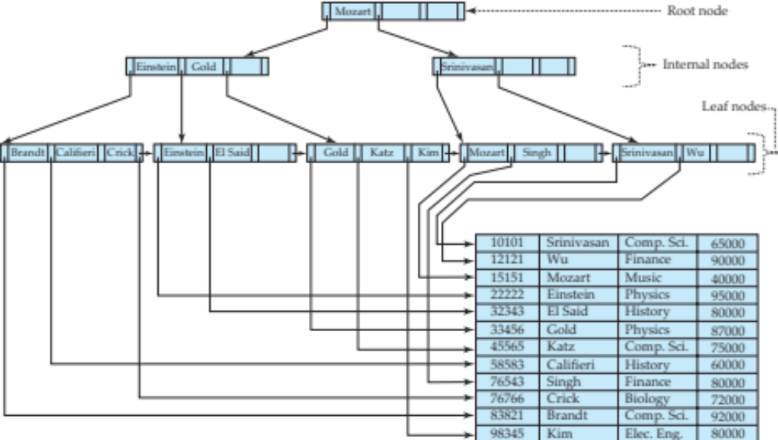
B⁺-Tree Index Files (Cont.)
A B⁺-tree is a rooted tree satisfying the following properties:
All paths from root to leaf are of the same length
Each node that is not a root or a leaf has between ⎡n/2⎤ and n children.
A leaf node has between ⎡(n–1)/2⎤ and n–1 values

Slide 5
B⁺-Tree Index Files (Cont.)
A B⁺-tree is a rooted tree satisfying the following properties:
Special cases:
  If the root is not a leaf, it has at least 2 children.
  If the root is a leaf (that is, there are no other nodes in the tree), it can have between 0 and (n–1) values.
Question 12-2: Find the minimum and maximum number of search keys in root, leaf and non-leaf nodes in B+ tree index structure with n = 99.

Slide 6
B⁺-Tree Node Structure
Typical node
  K_{i} are the search-key values
  P_{i} are pointers to children (for non-leaf nodes) or pointers to records or buckets of records (for leaf nodes).
The search-keys in a node are ordered K₁ < K₂ < K₃ < . . . < K_{n–1}

Slide 7
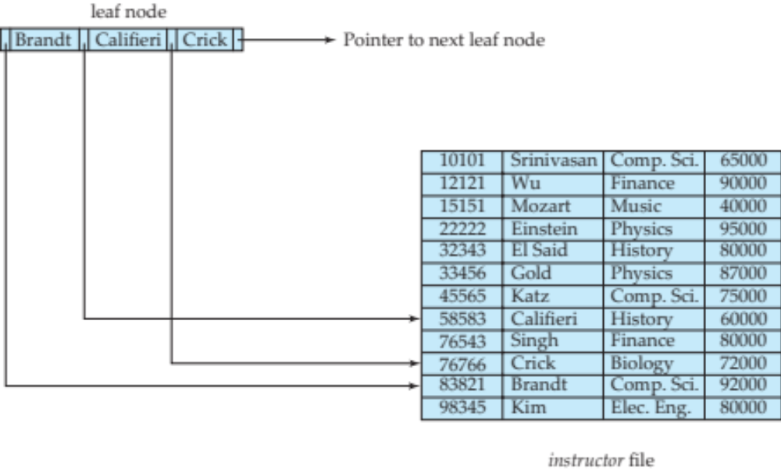
Leaf Nodes in B⁺-Trees
Properties of a leaf node:
For i = 1, 2, . . ., n–1, pointer P_{i} points to a file record with search-key value K_{i},
If L_{i}, L_{j} are leaf nodes and i < j, L_{i}’s search-key values are less than or equal to L_{j}’s search-key values
P_{n} points to next leaf node in search-key order

Slide 8
Non-Leaf Nodes in B⁺-Trees
Non leaf nodes form a multi-level sparse index on the leaf nodes. For a non-leaf node with m pointers:
  All the search-keys in the subtree to which P₁ points are less than K₁
  For 2 ≤ i ≤ n – 1, all the search-keys in the subtree to which P_{i} points have values greater than or equal to K_{i–1} and less than K_{i}
  All the search-keys in the subtree to which P_{n} points have values greater than or equal to K_{n–1}
  General structure

Slide 9
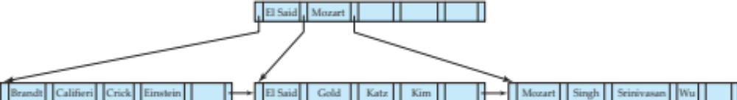
Example of B⁺-tree
B⁺-tree for instructor file (n = 6)
Leaf nodes must have between 3 and 5 values
(⎡(n–1)/2⎤ and n –1, with n = 6).
Non-leaf nodes other than root must have between 3 and 6 children (⎡(n/2⎤ and n with n =6).
Root must have at least 2 children.

Slide 10
Observations about B⁺-trees
The non-leaf levels of the B⁺-tree form a hierarchy of sparse indices.
The B⁺-tree contains a relatively small number of levels
    Level below root has at least 2* ⎡n/2⎤ values (For root, min = 2 child, for child minimum ⎡n/2⎤ child) ….
    Next level has at least 2* ⎡n/2⎤ * ⎡n/2⎤ values
    .. etc.
  If there are K search-key values in the file, the tree height is no more than ⎡ log_{⎡n/2⎤}(K)⎤

Slide 11
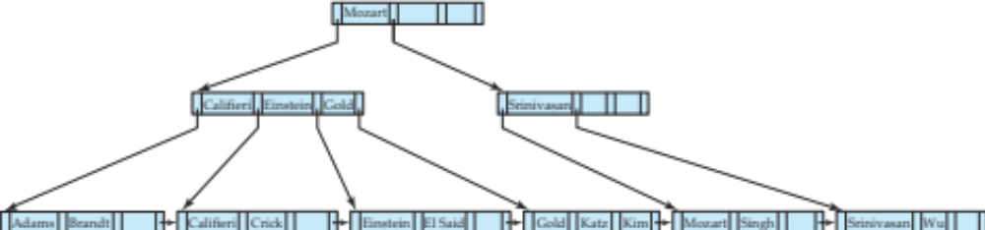
Queries on B⁺-Trees
Select *
From instructor
Where name = ‘Gold’
C = root
While (true)
I = 1
If (false)
Elseif (false)
Else (C = left child)
While (true)
I = 3
If (false)
Elseif (true) C = P₄
While (False)
Return node with ‘Gold’
function find(v)
  1. C=root
  2. while (C is not a leaf node)
    Let i be least number s.t. V ≤ K_{i}.
    if there is no such number i then
    Set C = last non-null pointer in C
    else if (v = C.K_{i} ) Set C = P_{i +1}
    else set C = C.P_{i}
  3. if for some i, K_{i} = V then return C.P_{i}
  4. else return null /* no record with search-key value v exists. */

Slide 12
Queries on B⁺-Trees
Question 13-1: Explain how the following queries will be executed using the given B+ tree index.
Select *
from instructor
where name = ‘Crick’
Select *
from instructor
where name = ‘Rafique’
Select *
From instructor
Where name = ‘Gold’
C = root
While (true)
I = 1
If (false)
Elseif (false)
Else (C = left child)
While (true)
I = 3
If (false)
Elseif (true) C = P₄
While (False)
Return node with ‘Gold’
function find(v)
  1. C=root
  2. while (C is not a leaf node)
    Let i be least number s.t. V ≤ K_{i}.
    if there is no such number i then
    Set C = last non-null pointer in C
    else if (v = C.K_{i} ) Set C = P_{i +1}
    else set C = C.P_{i}
  3. if for some i, K_{i} = V then return C.P_{i}
  4. else return null /* no record with search-key value v exists. */

Slide 13
Queries on B⁺-Trees (Cont.)
Range queries find all records with search key values in a given range
Select * from instructor where name < ‘Einstein’ ( No need tree traversal)
Select * from instructor where name > ‘Einstein’

Slide 14
Queries on B⁺⁻Trees (Cont.)
If there are K search-key values in the file, the height of the tree is no more than ⎡log_{⎡n/2⎤}(K)⎤.
A node is generally the same size as a disk block, typically 4 kilobytes
  and n is typically around 100 (40 bytes per index entry).
With 1 million search key values and n = 100
  at most log₅₀(1,000,000) = 4 nodes are accessed in a lookup traversal from root to leaf.
Contrast this with a balanced binary tree with 1 million search key values — around 20 nodes are accessed in a lookup
  above difference is significant since every node access may need a disk I/O, costing around 20 milliseconds

Slide 15
Updates on B⁺-Trees: Insertion
Assume record already added to the file. Let
  pr be pointer to the record, and let
  v be the search key value of the record
Find the leaf node in which the search-key value would appear
  If there is room in the leaf node, insert (v, pr) pair in the leaf node
  Otherwise, split the node (along with the new (v, pr) entry) as discussed in the next slide, and propagate updates to parent nodes.
Construct B+ tree for the search key values 0566,0981, 1350, 1360, 1383, 13120, 1472, 1548, 1651, 1659, 1701, 1702, 1703. The value of n = 5
1. Inserting 0566, 0981, 1350, 1360
 | 0566 |  | 0981 |  | 1350 |  | 1360

Slide 16
Updates on B⁺-Trees: Insertion
Assume record already added to the file. Let
  pr be pointer to the record, and let
  v be the search key value of the record
Find the leaf node in which the search-key value would appear
  If there is room in the leaf node, insert (v, pr) pair in the leaf node
  Otherwise, split the node (along with the new (v, pr) entry) as discussed in the next slide, and propagate updates to parent nodes.
Construct B+ tree for the search key values 0566,0981, 1350, 1360, 1383, 13120, 1472, 1548, 1651, 1659, 1701, 1702, 1703. The value of n = 5
1. Inserting 1383 require splitting of the node (How?)
 | 0566 |  | 0981 |  | 1350 |  | 1360

Slide 17
Updates on B⁺-Trees: Insertion (Cont.)
Splitting a leaf node:
  take the n (search-key value, pointer) pairs (including the one being inserted) in sorted order. Place the first ⎡n/2⎤ in the original node, and the rest in a new node. (Here n = 5, original node = 3, new node = 2 keys
  let the new node be p, and let k be the least key value in p. Insert (k,p) in the parent of the node being split.
  If the parent is full, split it and propagate the split further up.
Construct B+ tree for the search key values 0566,0981, 1350, 1360, 1383, 13120, 1472, 1548, 1651, 1659, 1701, 1702, 1703. The value of n = 5
1. Inserting 1383 require splitting of the node (How?)
 | 1360
 | 0566 |  | 0981 |  | 1350
 | 1360 |  | 1383

Slide 18
Updates on B⁺-Trees: Insertion (Cont.)
Splitting a leaf node:
  take the n (search-key value, pointer) pairs (including the one being inserted) in sorted order. Place the first ⎡n/2⎤ in the original node, and the rest in a new node. (Here n = 5, original node = 3, new node = 2 keys
  let the new node be p, and let k be the least key value in p. Insert (k,p) in the parent of the node being split.
  If the parent is full, split it and propagate the split further up.
Construct B+ tree for the search key values 0566,0981, 1350, 1360, 1383, 1395, 1472, 1548, 1651, 1659, 1701, 1702, 1703. The value of n = 5
Question 14-1: Show the B+ tree structure after inserting 1395, 1472, 1548, 1651 into the following tree.
 | 1360
 | 0566 |  | 0981 |  | 1350
 | 1360 |  | 1383

Slide 19
Updates on B⁺-Trees: Insertion (Cont.)
Construct B+ tree for the search key values 0566,0981, 1350, 1360, 1383, 1395, 1472, 1548, 1651, 1659, 1701, 1702, 1703. The value of n = 3
Insert 1472
 | 1350 |  | 1383
 | 0566 |  | 0981
 | 1350 |  | 1360
 | 1383 |  | 1395

Slide 20
Updates on B⁺-Trees: Insertion (Cont.)
Construct B+ tree for the search key values 0566,0981, 1350, 1360, 1383, 1395, 1472, 1548, 1651, 1659, 1701, 1702, 1703. The value of n = 3
 | 1383
 | 1350
 | 1472
 | 0566 |  | 0981
 | 1350 |  | 1360
 | 1383 |  | 1395
 | 1472 |  | 1548

Slide 21
Updates on B⁺-Trees: Insertion (Cont.)
Construct B+ tree for the search key values 0566,0981, 1350, 1360, 1383, 1395, 1472, 1548, 1651, 1659, 1701, 1702, 1703. The value of n = 3
Insert 1701
It requires the reorganization of the internal nodes. Tree height will not be increased.
 | 1383
 | 1350
 | 1472 |  | 1651
 | 0566 |  | 0981
 | 1350 |  | 1360
 | 1383 |  | 1395
 | 1472 |  | 1548
 | 1651 |  | 1659

Slide 22
Updates on B⁺-Trees: Insertion (Cont.)
Construct B+ tree for the search key values 0566,0981, 1350, 1360, 1383, 1395, 1472, 1548, 1651, 1659, 1701, 1702, 1703. The value of n = 3
Insert 1701
It requires the reorganization of the internal nodes. Tree height will not be increased.
 | 1472
 | 1350 |  | 1383
 | 1651 |  | 1701
 | 0566 |  | 0981
 | 1350 |  | 1360
 | 1383 |  | 1395
 | 1472 |  | 1548
 | 1651 |  | 1659
 | 1701 |  | 1702

Slide 23
Updates on B⁺-Trees: Insertion (Cont.)
Splitting a leaf node:
  take the n (search-key value, pointer) pairs (including the one being inserted) in sorted order. Place the first ⎡n/2⎤ in the original node, and the rest in a new node.
  let the new node be p, and let k be the least key value in p. Insert (k,p) in the parent of the node being split.
  If the parent is full, split it and propagate the split further up.
Splitting of nodes proceeds upwards till a node that is not full is found.
  In the worst case the root node may be split increasing the height of the tree by 1.
Result of splitting node containing Brandt, Califieri and Crick on inserting Adams
Next step: insert entry with (Califieri, pointer-to-new-node) into parent

Slide 24
B⁺-Tree Insertion
Affected nodes
B⁺-Tree before and after insertion of “Adams”

Slide 25
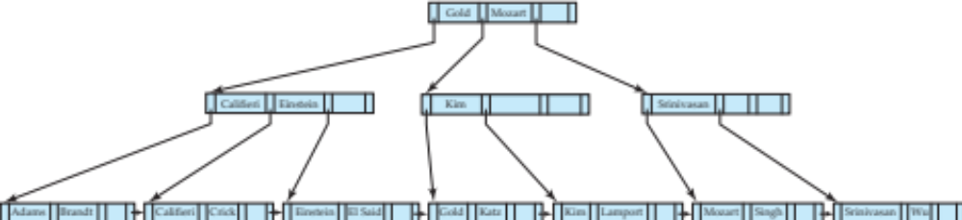
B⁺-Tree Insertion
B⁺-Tree before and after insertion of “Lamport”
Affected nodes
Affected nodes

Slide 26
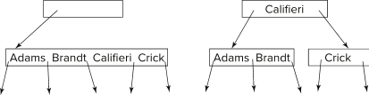
Insertion in B⁺-Trees (Cont.)
Splitting a non-leaf node: when inserting (k,p) into an already full internal node N
  Copy N to an in-memory area M with space for n+1 pointers and n keys
  Insert (k,p) into M
  Copy P₁,K₁, …, K _{⎡n/2⎤-1},P _{⎡n/2⎤} from M back into node N
  Copy P_{⎡n/2⎤+1},K _{⎡n/2⎤+1},…,K_{n},P_{n+1} from M into newly allocated node N'
  Insert (K _{⎡n/2⎤},N') into parent N
Example
Read pseudocode in book!

Slide 27
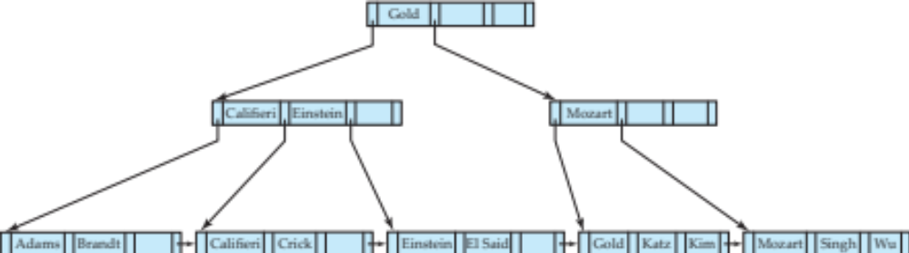
Examples of B⁺-Tree Deletion
Before and after deleting “Srinivasan”
Affected nodes
Deleting “Srinivasan” causes merging of under-full leaves

Slide 28
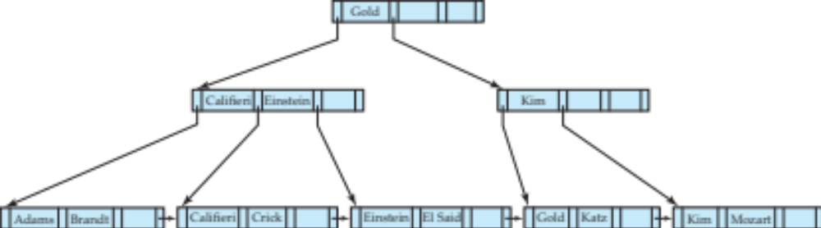
Examples of B⁺-Tree Deletion (Cont.)
Before and after deleting “Singh” and “Wu”
Affected nodes
Leaf containing Singh and Wu became underfull, and borrowed a value Kim from its left sibling
Search-key value in the parent changes as a result

Slide 29
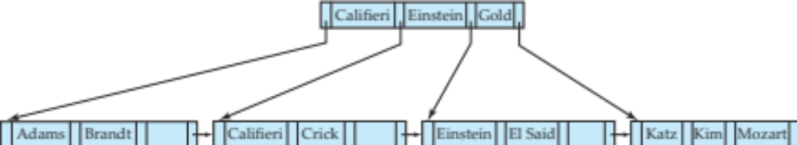
Example of B⁺-tree Deletion (Cont.)
Before and after deletion of “Gold”
Node with Gold and Katz became underfull, and was merged with its sibling
Parent node becomes underfull, and is merged with its sibling
  Value separating two nodes (at the parent) is pulled down when merging
Root node then has only one child, and is deleted

Slide 30
Updates on B⁺-Trees: Deletion
Assume record already deleted from file. Let V be the search key value of the record, and Pr be the pointer to the record.
Remove (Pr, V) from the leaf node
If the node has too few entries due to the removal, and the entries in the node and a sibling fit into a single node, then merge siblings:
  Insert all the search-key values in the two nodes into a single node (the one on the left), and delete the other node.
  Delete the pair (K_{i–1}, P_{i}), where P_{i} is the pointer to the deleted node, from its parent, recursively using the above procedure.

Slide 31
Updates on B⁺-Trees: Deletion
Otherwise, if the node has too few entries due to the removal, but the entries in the node and a sibling do not fit into a single node, then redistribute pointers:
  Redistribute the pointers between the node and a sibling such that both have more than the minimum number of entries.
  Update the corresponding search-key value in the parent of the node.
The node deletions may cascade upwards till a node which has ⎡n/2⎤ or more pointers is found.
If the root node has only one pointer after deletion, it is deleted and the sole child becomes the root.

